Slide 1


Graphene and Silver NanoWire hybridization for the fabrication of Transparent Conductors (SiGraTraCo)
Gestão de Ciência e Tecnologia
António Balula – 72735
Luís Macedo – 73633
Pedro Ribeiro – 73221

Slide 2
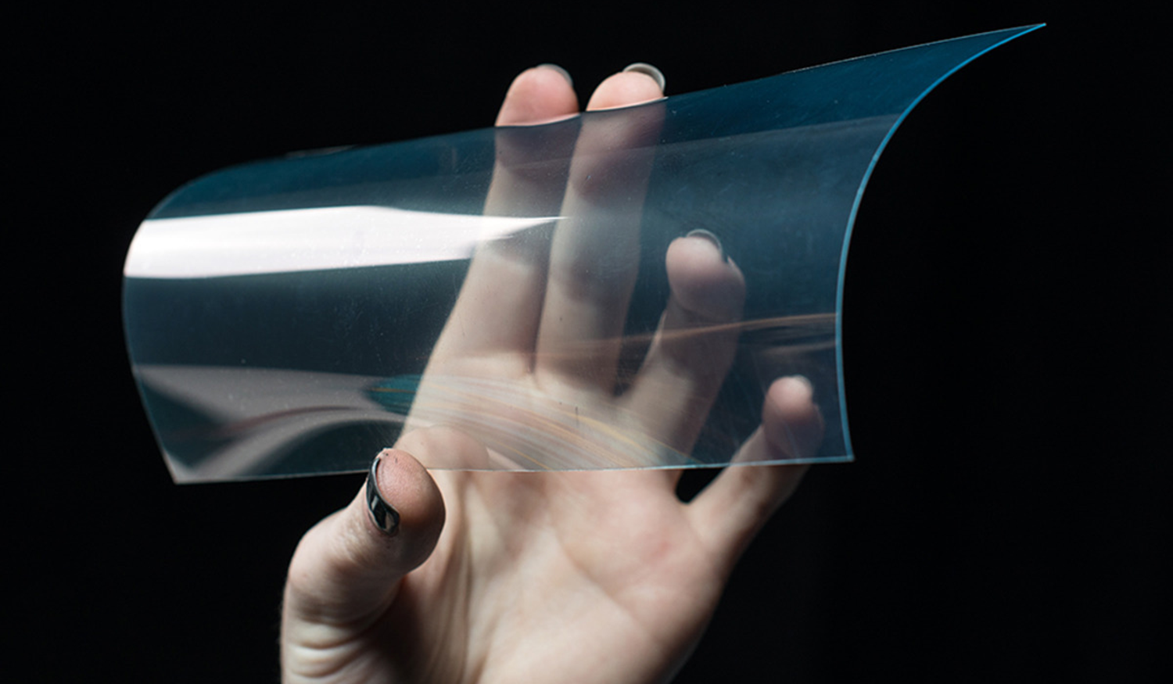
Rationale
Transparent Conductive Thin Films
Hybridization of Graphene and Silver NanoWires
Budget: 108 126,62€
FCT

Slide 3
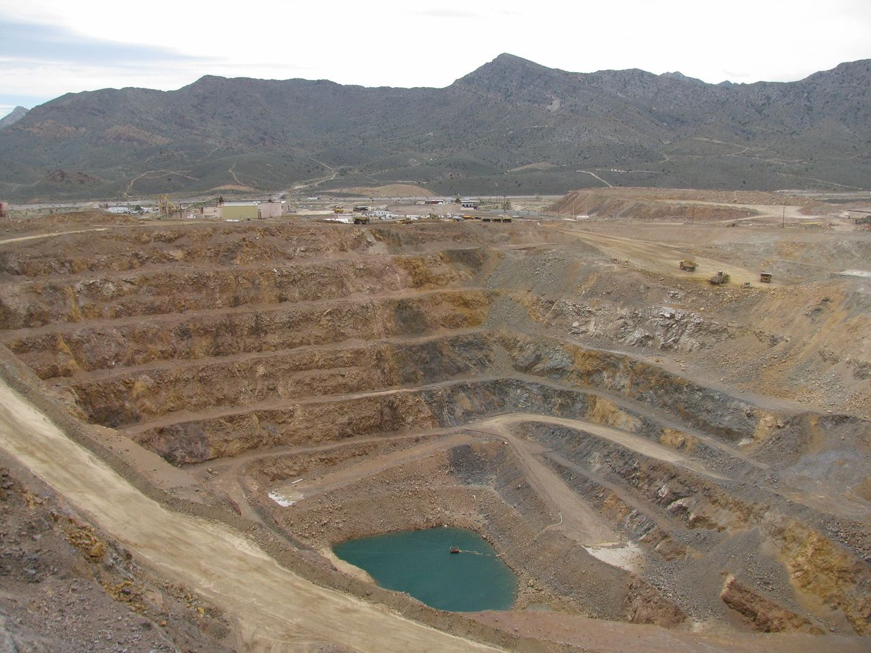
Motivation
TCF: A key electronic component
ITO scarcity
Lack of alternatives

Slide 4
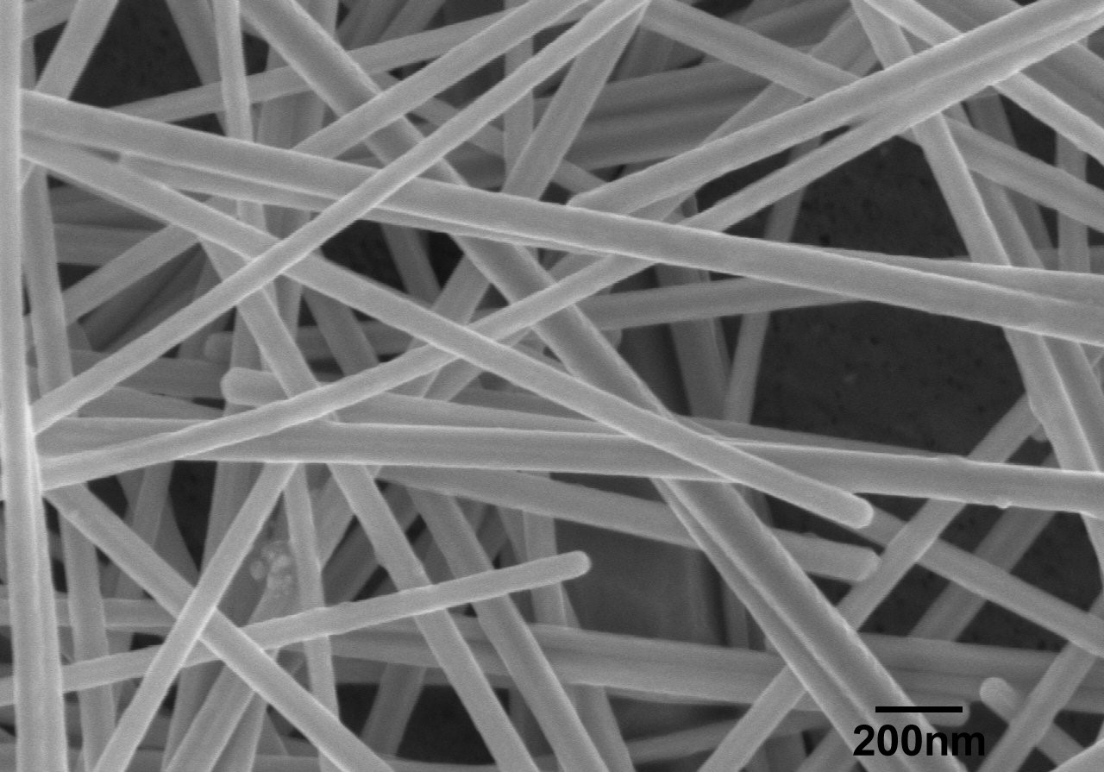
State of the art
Conductive Polymers
Silver Nanowire Networks
Graphene Thin Films
Carbon Nanowire Thin Films
Technically or Commercially unviable

Slide 5
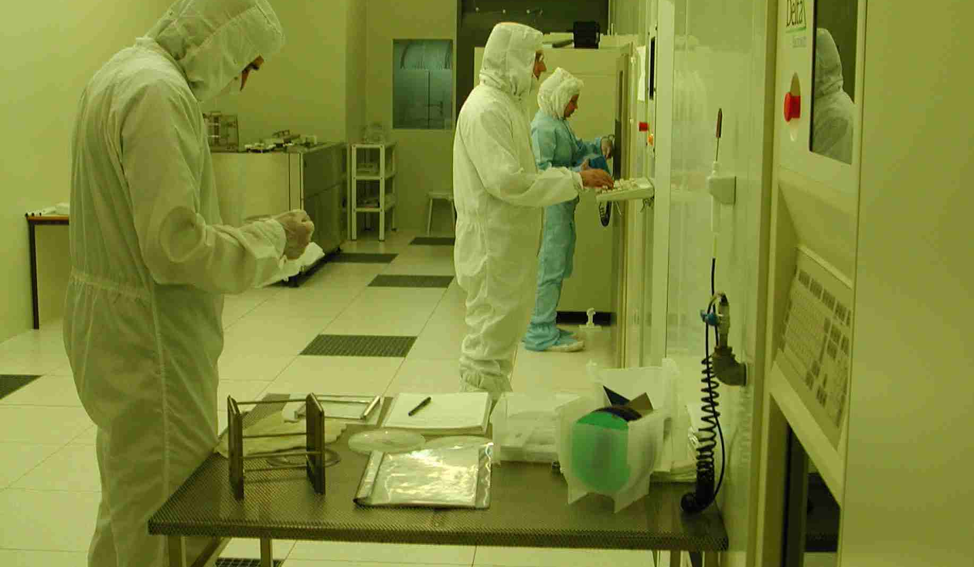
INESC-MN
Instituto de Engenharia de Sistemas e Computadores – Microssistemas e Nanotecnologias

Slide 6

Dr. António Balula
Francesca Malakova
B. Iniciação Científica
Dr. Pedro Ribeiro
Francesca Malakova
Dr. Luis Macedo
B. Licenciado 1
Pancráceo Silva
B. Licenciado 2
Drª. Susana Freitas
Computer Simulation Group
Fabrication Group
Characterization Group

Slide 7
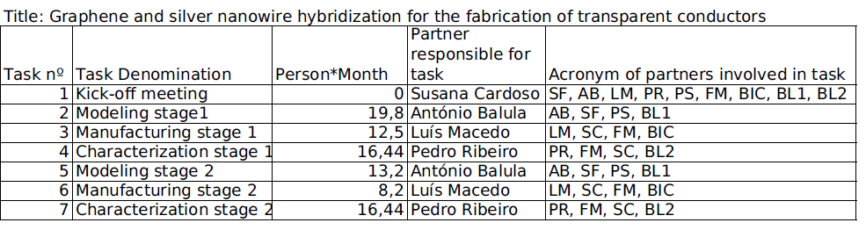
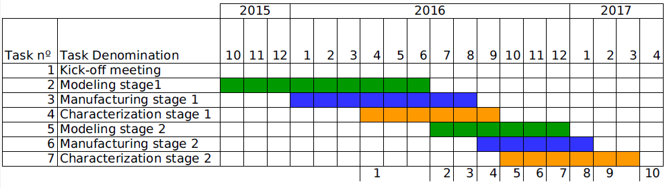
Timeline
Total Person*Month: 81,2
Project Duration: 18 months

Slide 8
Deliverables

Slide 9
Budget
108 526,62€

Slide 10
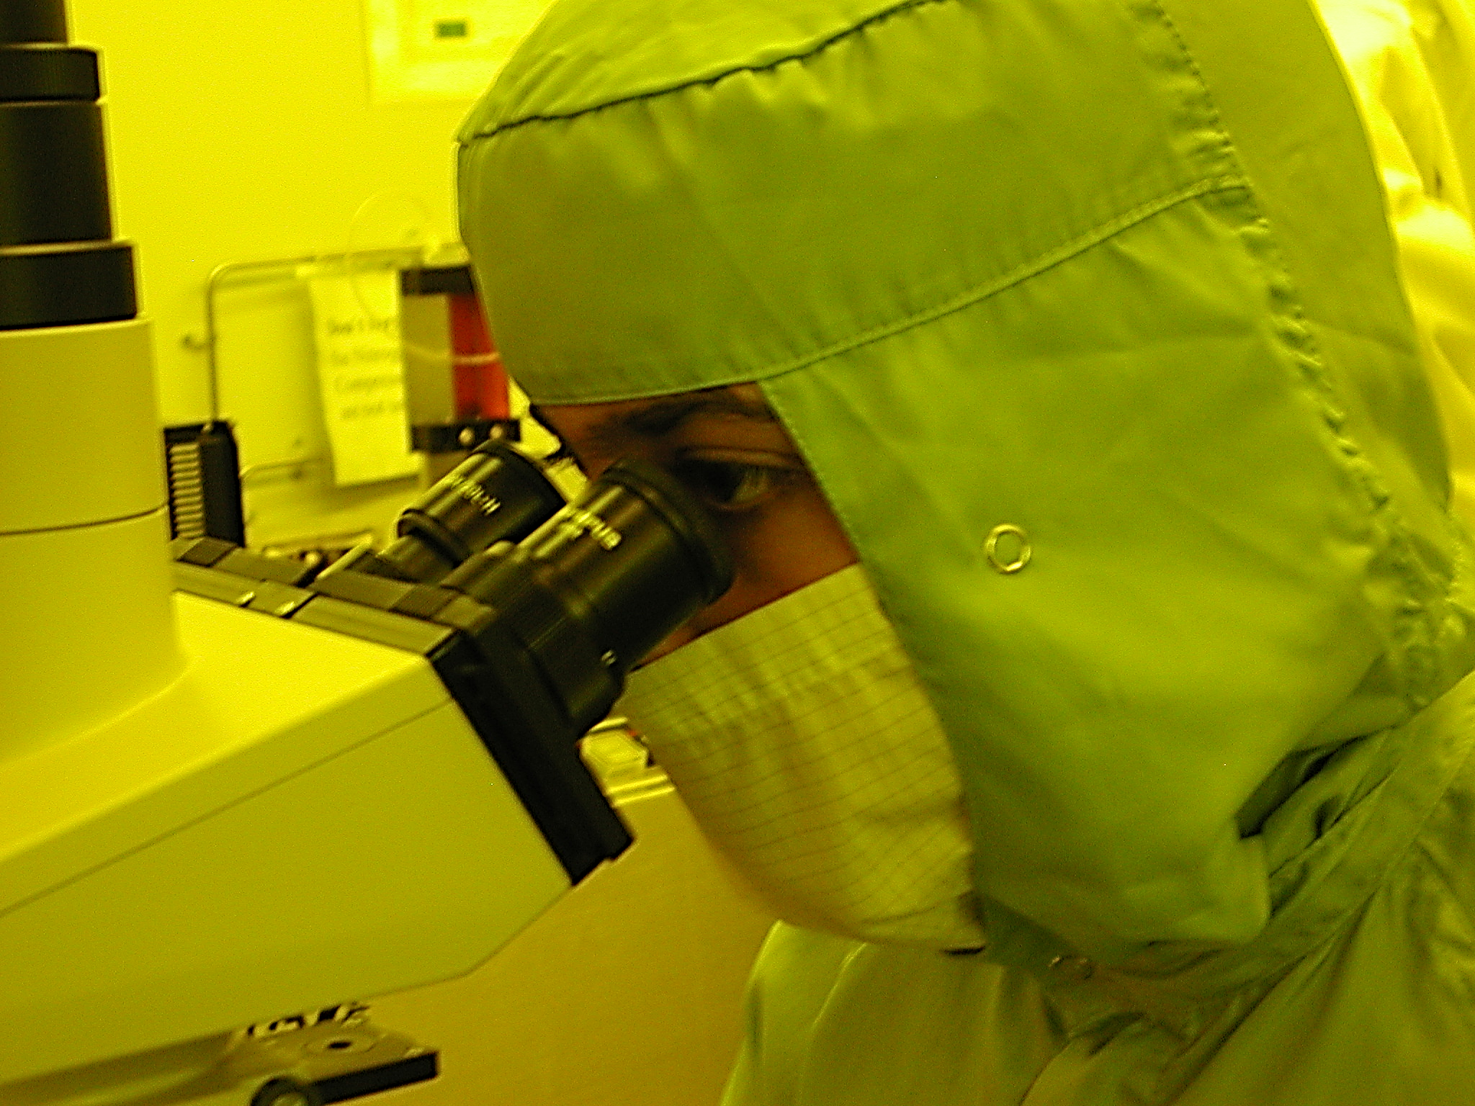
Why Us?
Experience
Infrastructures
Know-How
Why SiGraTraCo?
Solution to a relevant problem
To make Portugal a leading player in TCFs
Economical return

